Slide 1


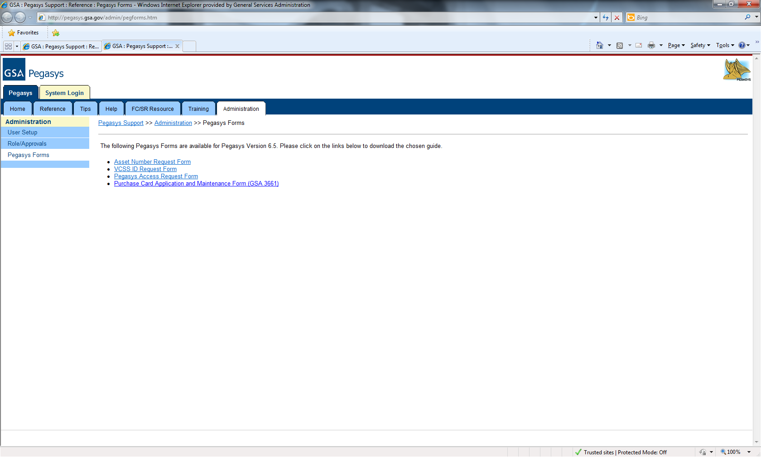
Functional Coordinator/Service Representative
Quick Reference Card
U.S. General Services Administration
Where to Send Documents/Requests
USER REQUEST MATRIX
Services | Information/Document/Forms | Send to
Credit Card Changes | Name of Reconciler and/or email recipients | codeimplementation@gsa.gov
Approving Officer changes | Officer changes | Your Credit Card Coordinator
Loading Accounting Templates | Template - approval required | codeimplementation@gsa.gov
E2 Codes & Accounting Templates | E2 Forms | codeimplementation@gsa.gov
Updating Existing Reference Data | Email requesting update | codeimplementation@gsa.gov
New User Request | Pegasys User Request Form | OCFOservicedesk@gsa.gov
New User Request - Finance | Pegasys User Request Form | Joyce.Deanell@gsa.gov
Adding Roles or Approvals | Pegasys User Request Form | OCFOservicedesk@gsa.gov
Miscellaneous Security Errors | Security errors | OCFOservicedesk@gsa.gov
New Coding | Financial Code Change Form | SSOcode.request@gsa.gov
Access to an existing code | Send Email Request | codeimplementation@gsa.gov
VCSS Access | VCSS ID Request Form | OCFOservicedesk@gsa.gov
The Financial Management
Information System
Where to Find Forms
Key Forms can be found at: http://pegasys.gsa.gov/admin/pegforms.htm

